Slide 1
VETMARKETS.COM
VETMARKET.COM is a system proposed to be marketed in concert to the Veteran marketplace by NVSBC and the database vendor - Proxity
System is a database providing intelligent data from the FBO world as well as State and Local Governments and DLA for parts companies
The system is currently used by half of the PTAC community as well as others such as Brevard County for their G.O.Contracts
Proxity has over 2,000 users receiving data on a daily basis

Slide 2
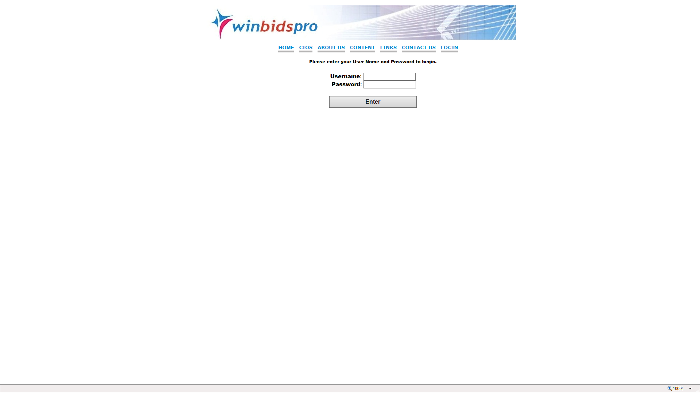
Each user is assigned a username as well as a password–
multiple users may use the same password but only one at a time
The National Veteran Small Business Coalition database provides research data as well as marketing knowledge and comprehensive bid opportunities unlike ANY company or Government organization in the world

Slide 3
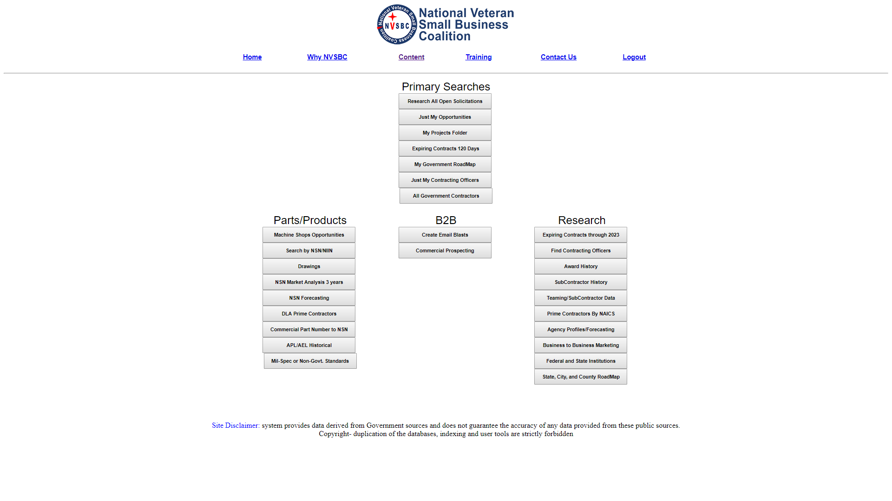
The National Veteran Small Business Coalition database is organized to allow the user to do market research on what is being acquired by the Government - who are the acquisition people involved - who is the current incumbent contractors and so on - all research you require to successfully market to either the Military or Federal Government. National Veteran Small Business Coalition also provides two databases, one via email and one in the National Veteran Small Business Coalition system that notifies you of any opportunity that matches a profile that your organization and National Veteran Small Business Coalition set up. The daily emails contain not only salient bid response information but technical data that may be required RESEARCH- MARKETING- SALES ASSISTANCE

Slide 4
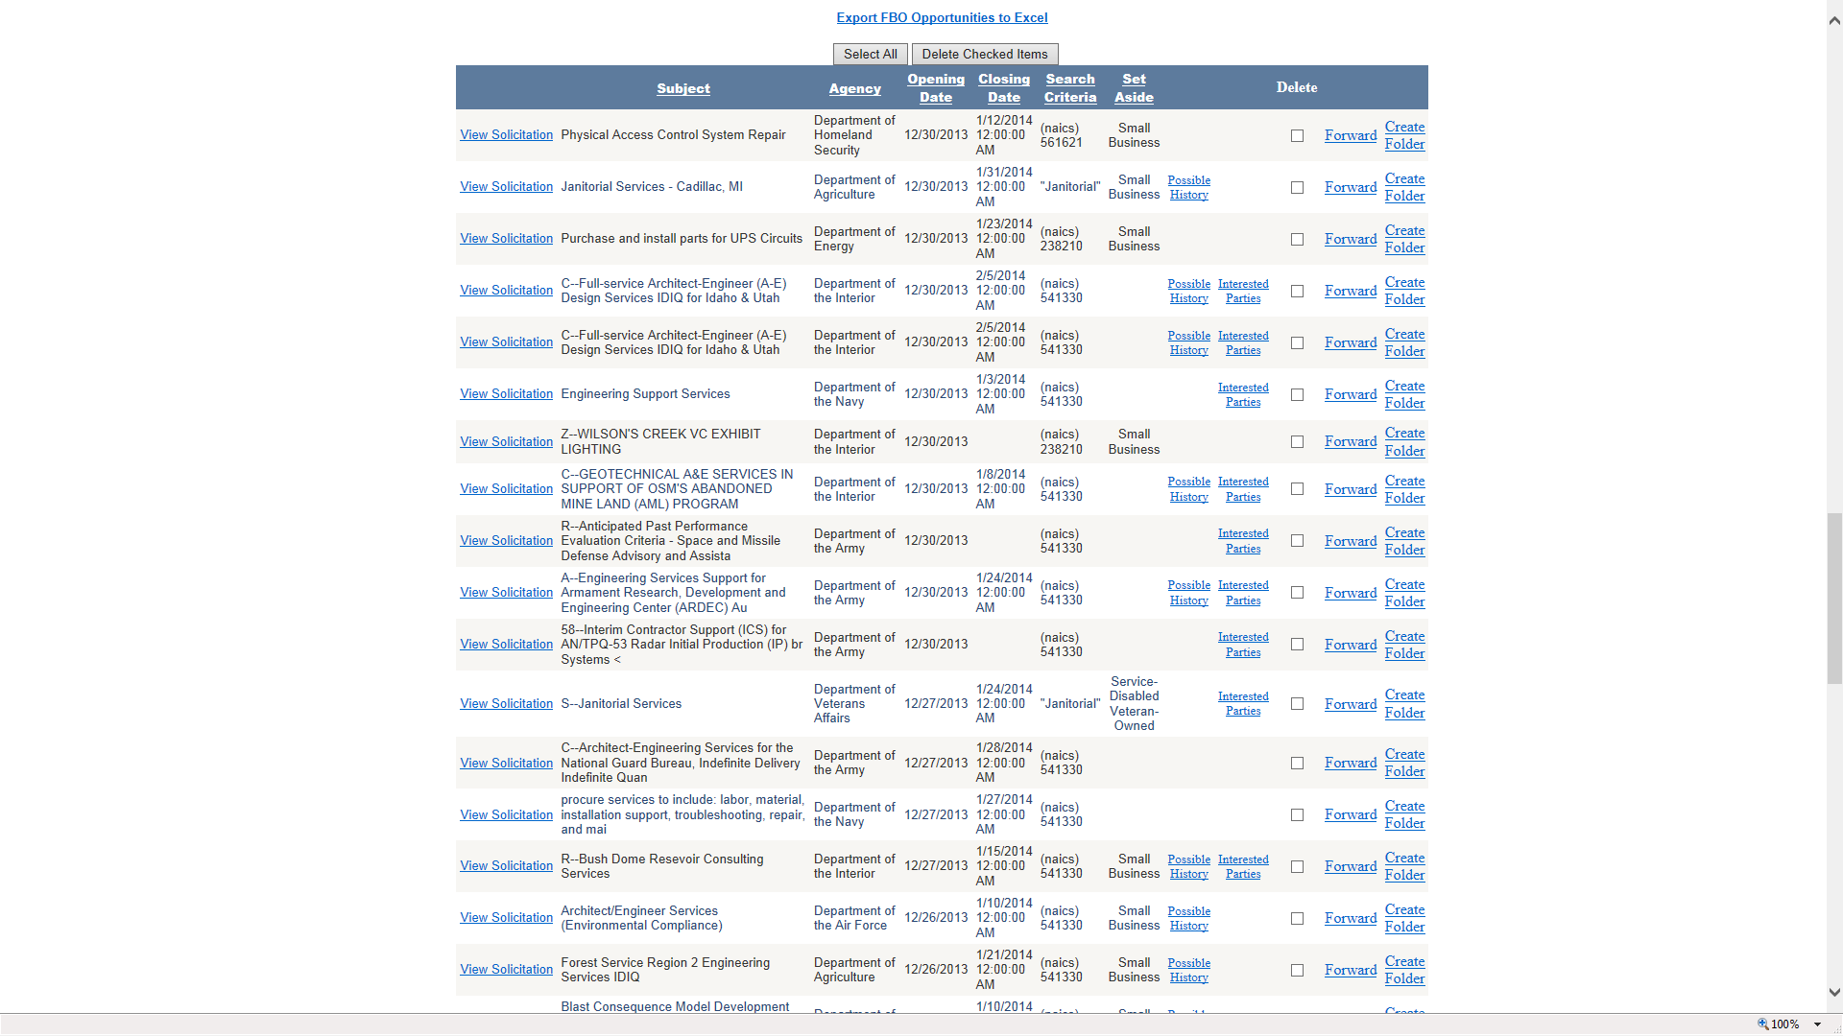
Daily bid notices either via email or in the National Veteran Small Business Coalition database show how much the bid may be worth and is a unique National Veteran Small Business Coalition feature which no one provides. In the world of parts National Veteran Small Business Coalition provides award history back to 1961 on ALL successful contract awards. By “clicking” on the NSN tech data links will appear. Bid data comes from 3 Army sites- all Air Force - Navy and DLA as well as FBO and state and local

Slide 5
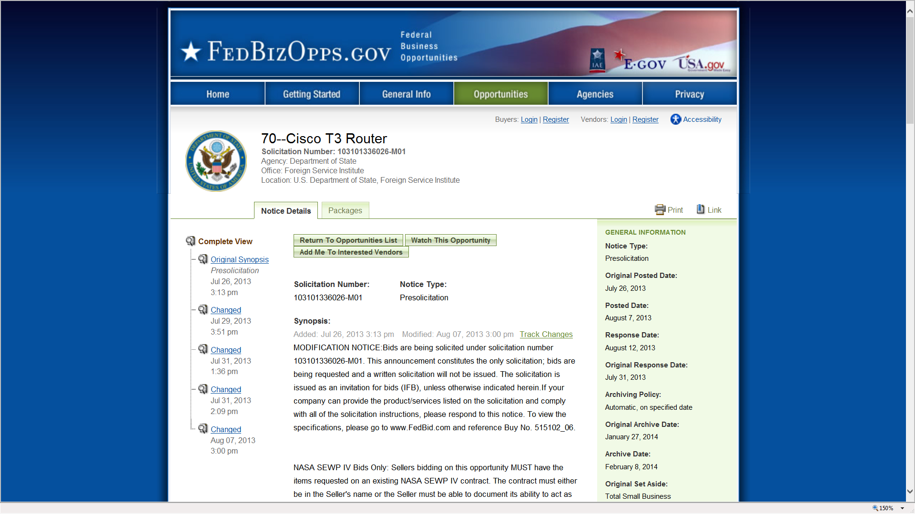
When looking at daily opportunities the system hyper-links to FBO - NECO-DLA-Army or the appropriate State and local Government site showing the solicitation
Notes:
When looking at daily opportunities the system hyper-links to FBO- NECO-DLA-Army or the appropriate State and local Government site showing the soliciation

Slide 6
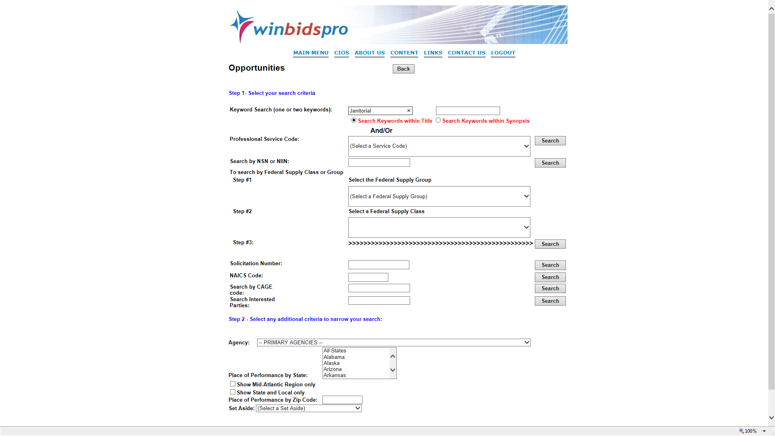
Home | Why NVSBC | Content | Training | Contact Us | Logout
Once the user has assisted in building a profile of key words or NSN or NAICS or Federal Supply Classes which are monitored for daily bids
The user will receive daily notices however the system allows users to manually check for bid opportunities in a variety of means including key words, NO OTHER system Government or industry provides this feature

Slide 7
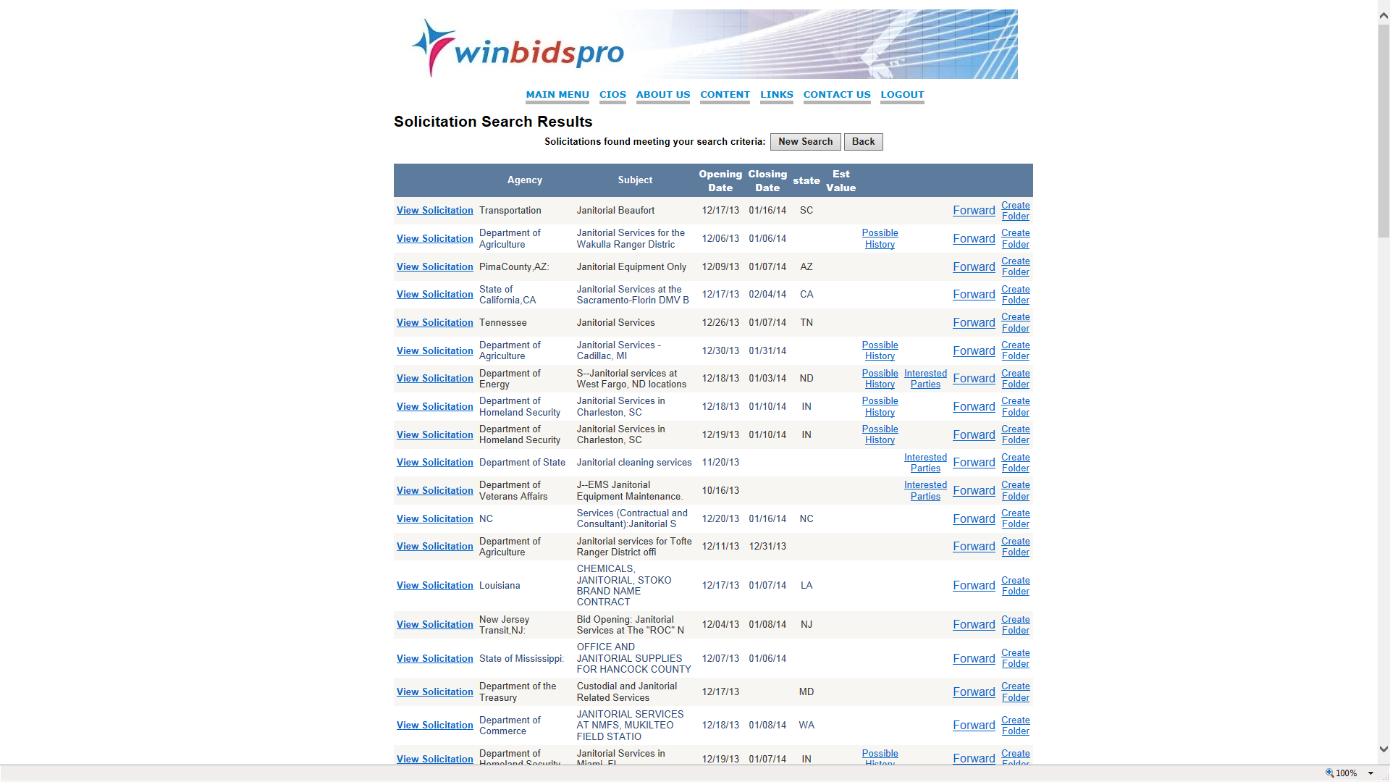
Home | Why NVSBC | Content | Training | Contact Us | Logout
Once the search button is hit a list of potential bids will appear, this could have been modified by State, agency or size of business standard

Slide 8
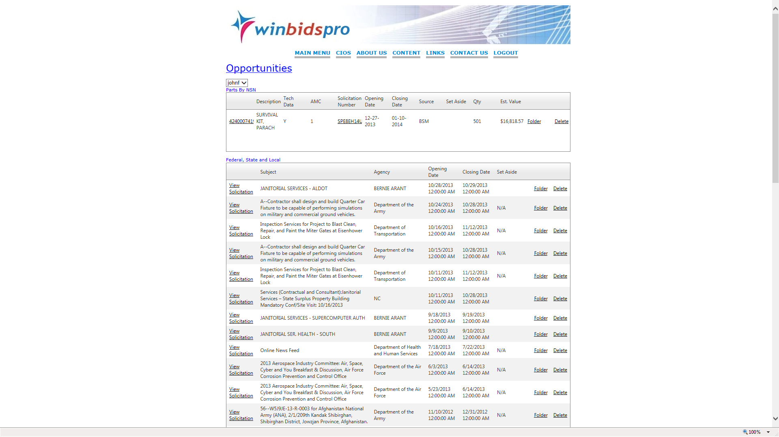
Home | Why NVSBC | Content | Training | Contact Us | Logout
Folders may be created and used when looking at daily opportunities or expiring contracts - the history of the opportunity will be gathered in the folder automatically

Slide 9
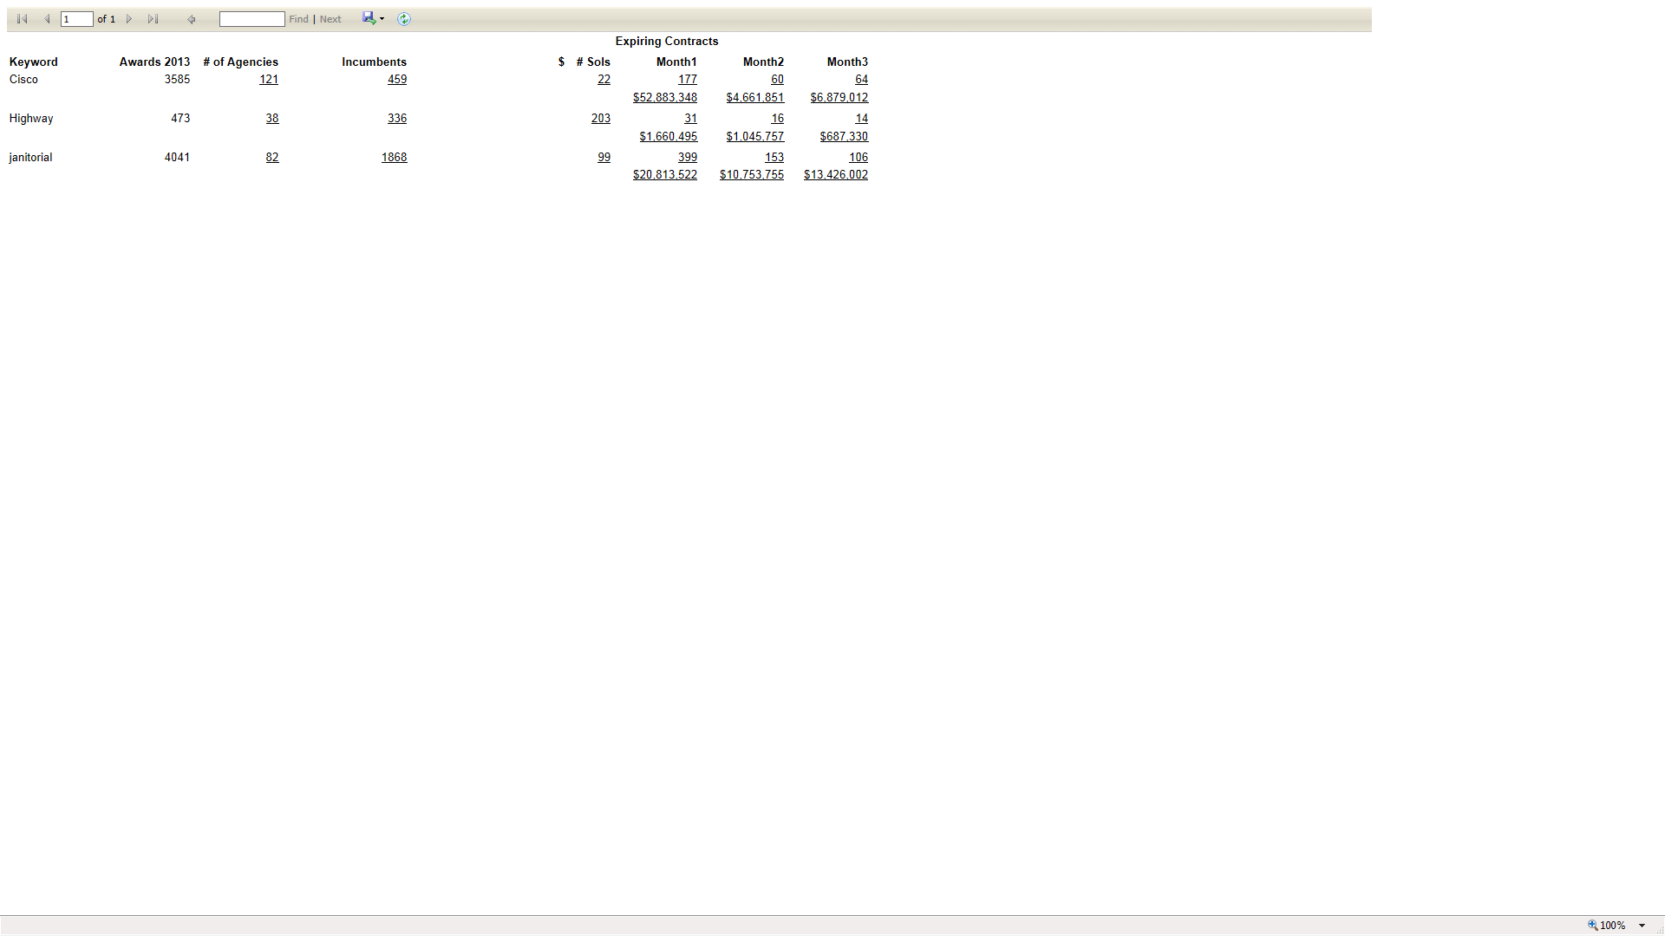
In the MY FAVORITIES there is a selection called MY NINETY DAY WINDOW and are the expiring contracts coming up over the following ninety days - these are based upon KEY WORDS provided in the profile of your account

Slide 10
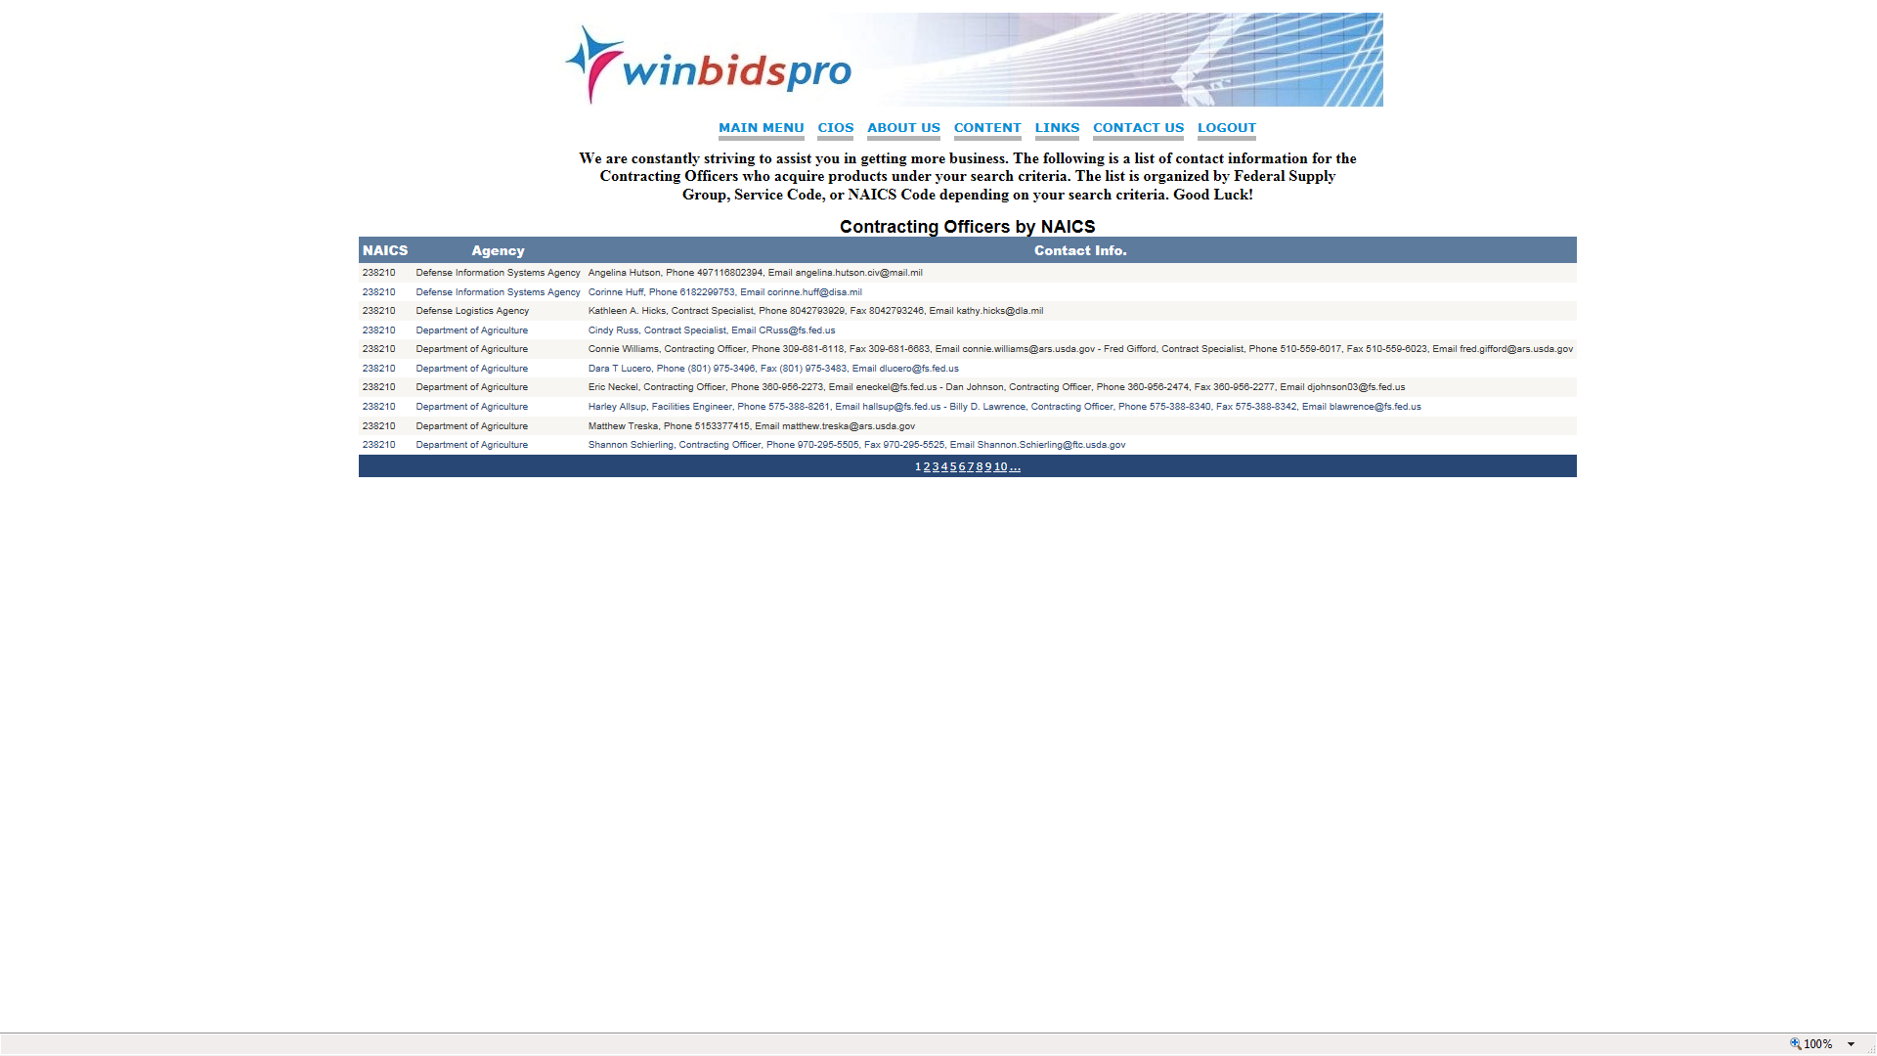
Home | Why NVSBC | Content | Training | Contact Us | Logout
Contracting Officer data may be found in the ALL CONTRACTING OFFICERS by NAICs- KEY WORD- FSC- PSC and sub divided by State- Agency or zip- In the JUST MY CONTRACTING OFFICERS the contracting officers arte provided by NAICS

Slide 11
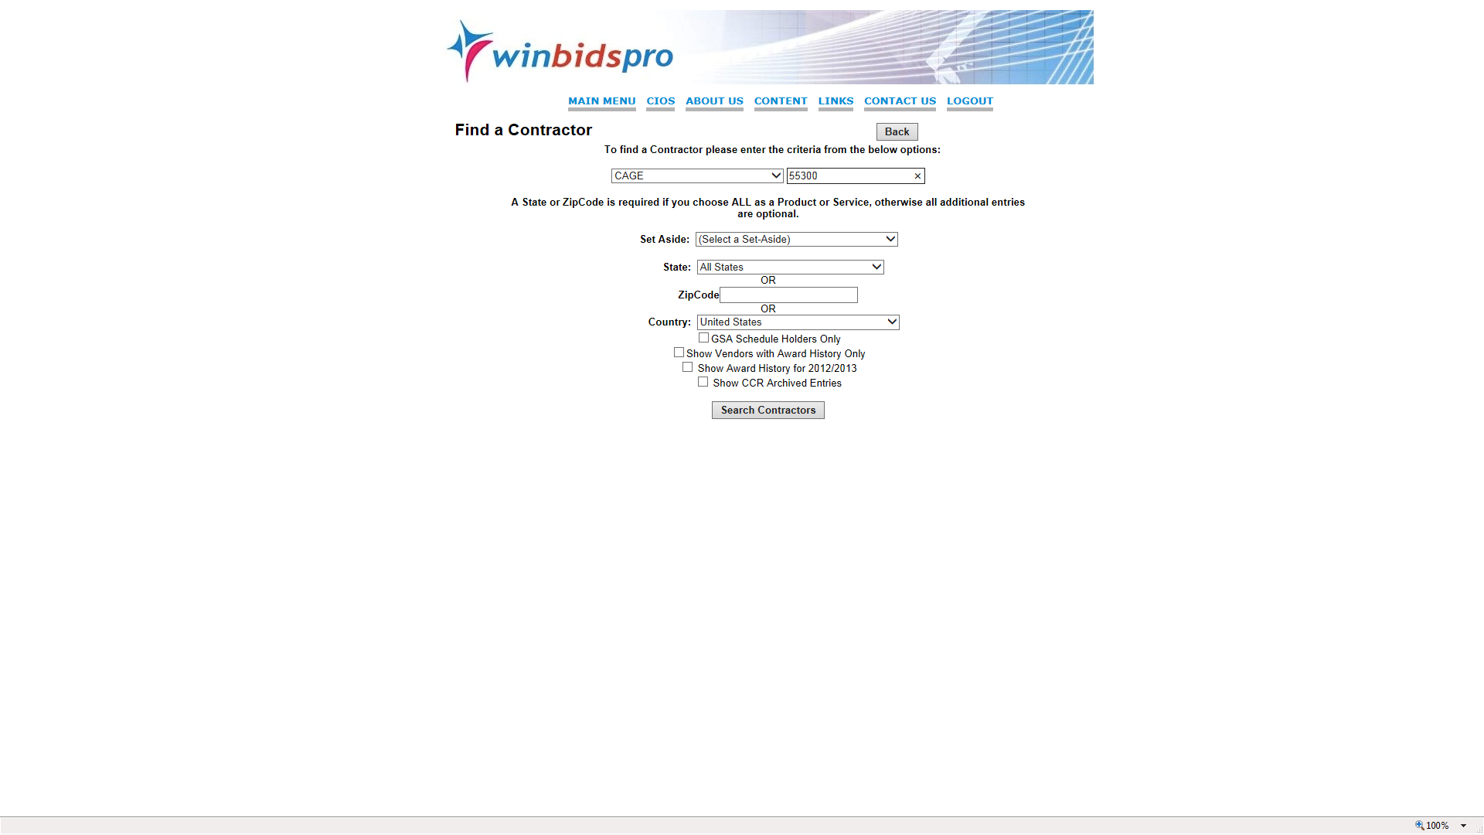
Home | Why NVSBC | Content | Training | Contact Us | Logout
In the vendor search- user may search using any number of combination of search criteria to prospect in the commercial world by zip or key word, company name, and other search methods- there is a second pull down box which allows two search methods plus searching within a state- another totally unique feature of National Veteran Small Business Coalition

Slide 12
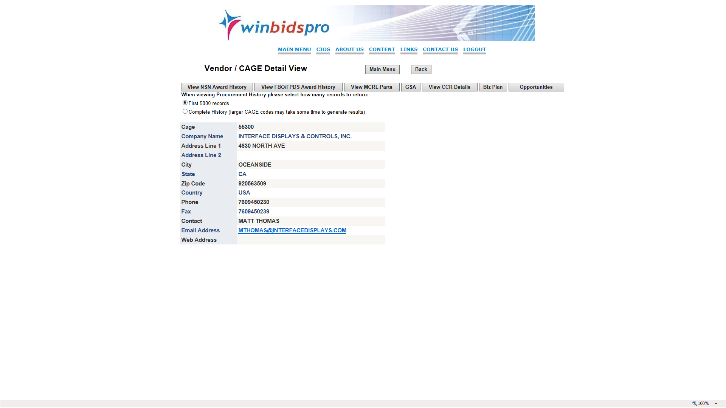
Home | Why NVSBC | Content | Training | Contact Us | Logout
Contractor database includes award history, key contact data in hundreds of thousands of cases as well as awards for parts and services. System provides listing of DoD preference for contractor parts in MCRL.National Veteran Small Business Coalition provides 400,000 emails

Slide 13
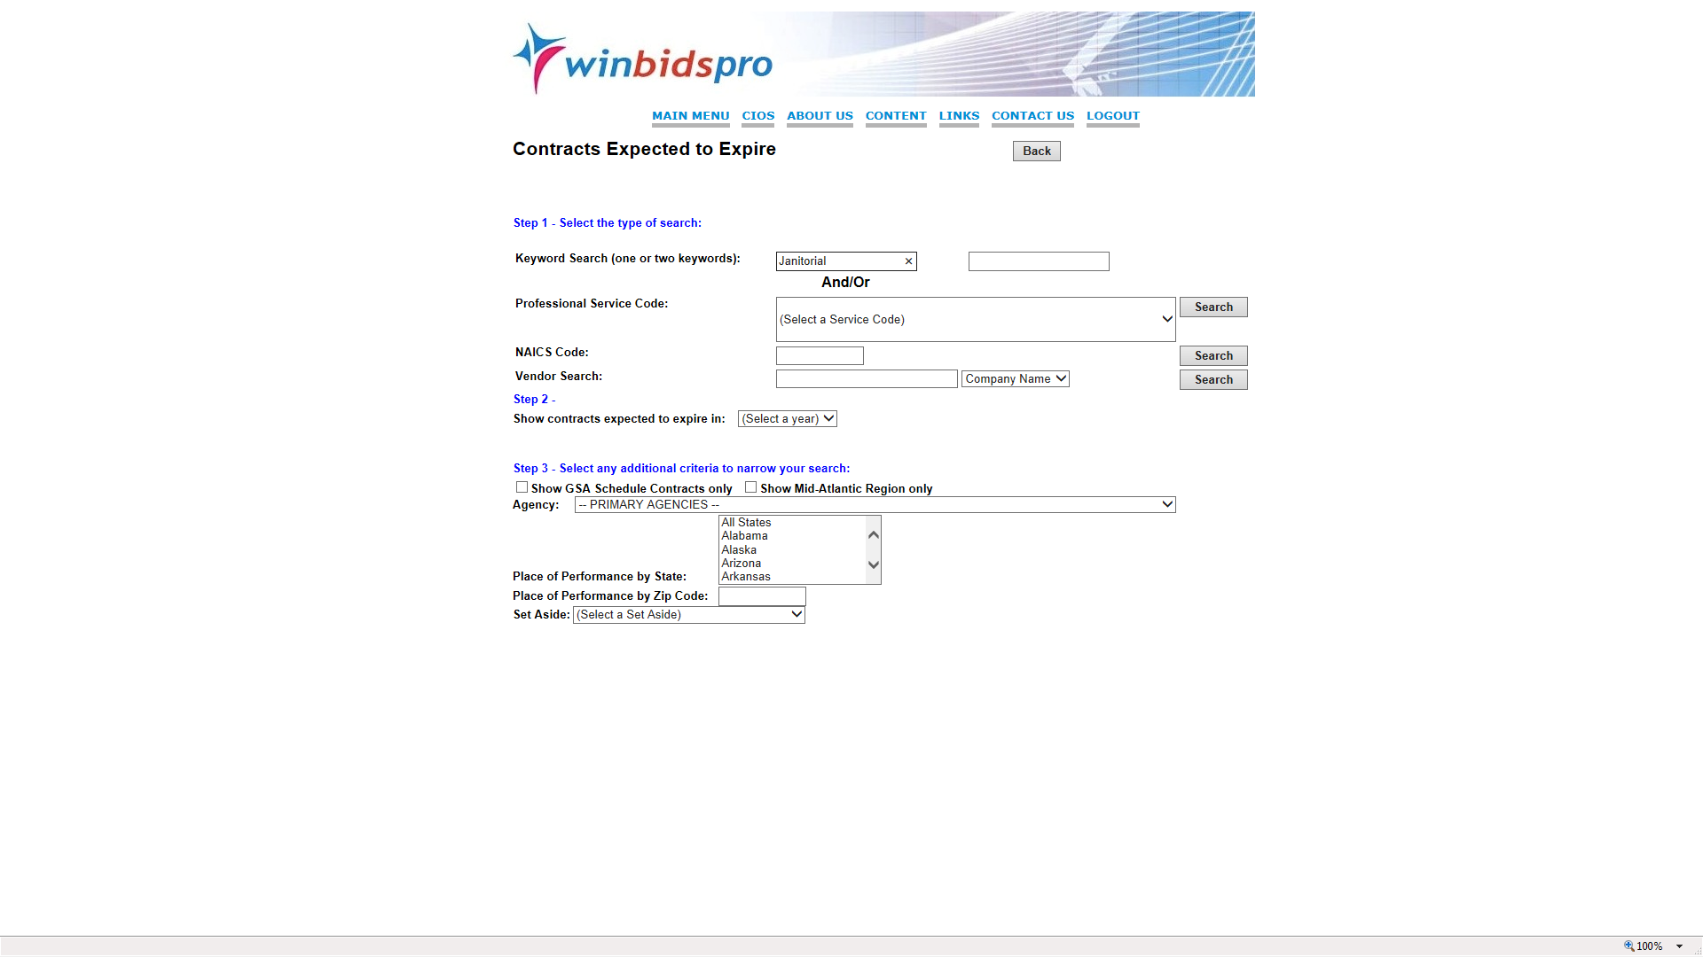
Home | Why NVSBC | Content | Training | Contact Us | Logout
The user may be providing a service that has a term of expiration and a drop down is provided to select years out to 2018 - as well as contracts only on GSA or a zip code of interest

Slide 14
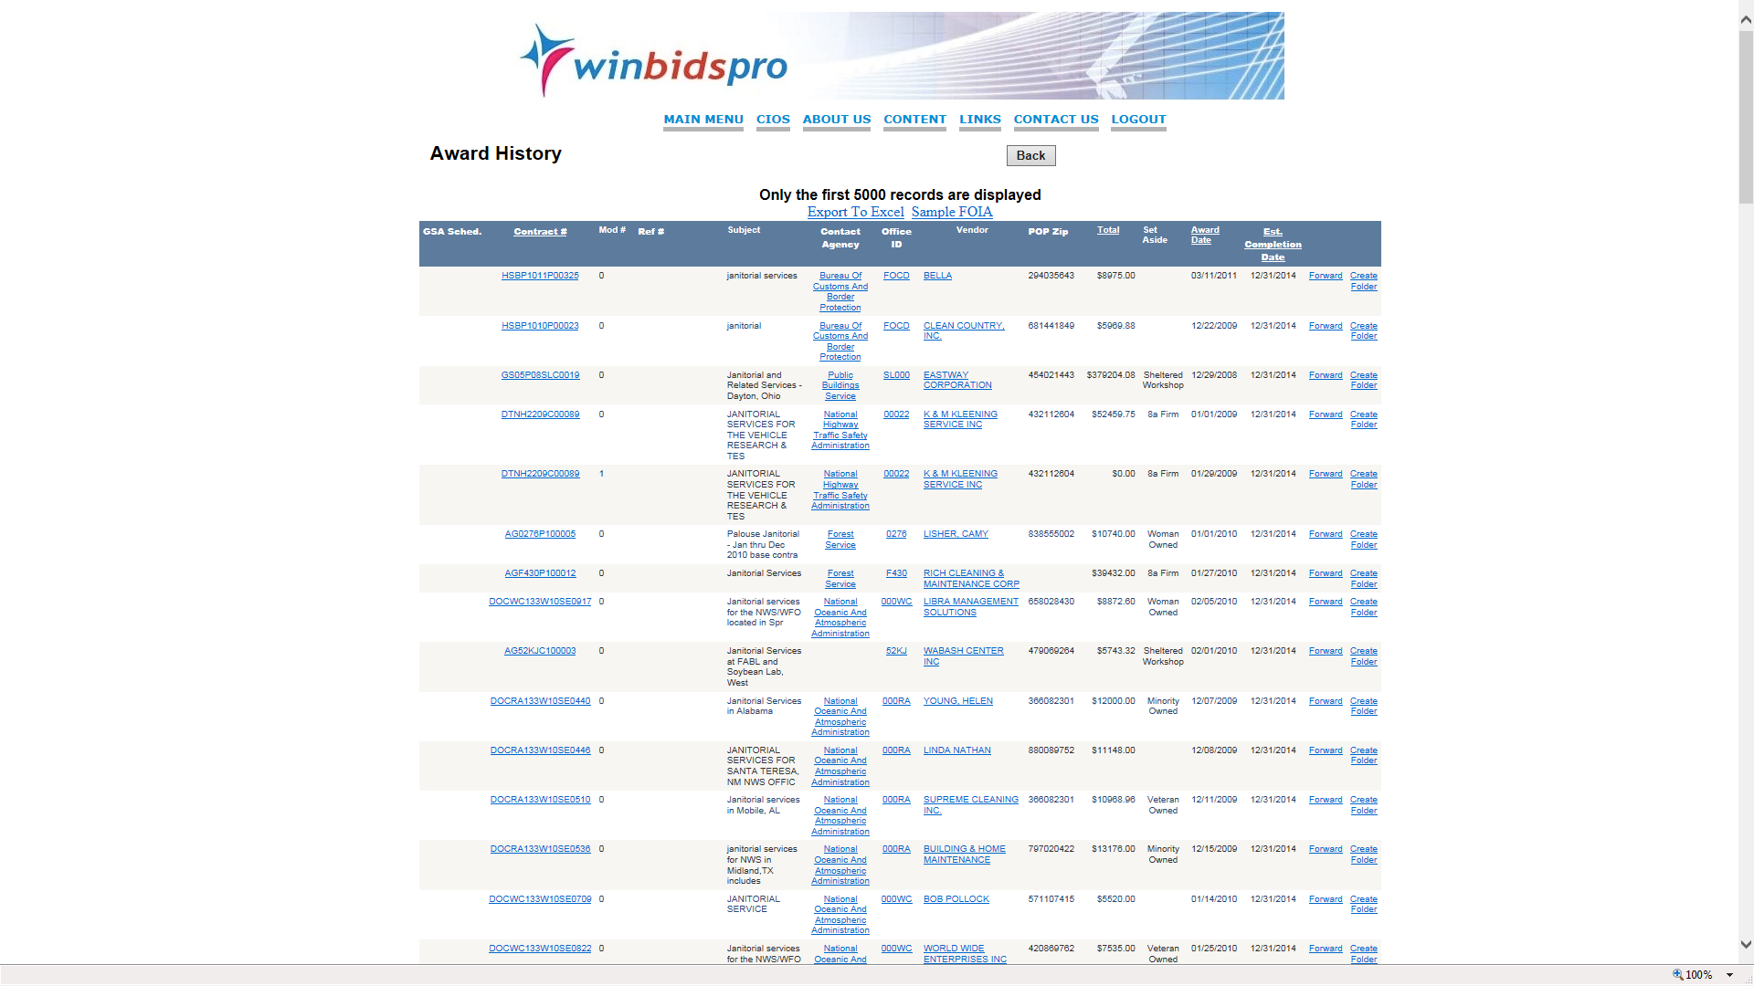
Home | Why NVSBC | Content | Training | Contact Us | Logout
Results provide not only key contact data but size of award- name of company and award number as well as links to Government contract data

Slide 15
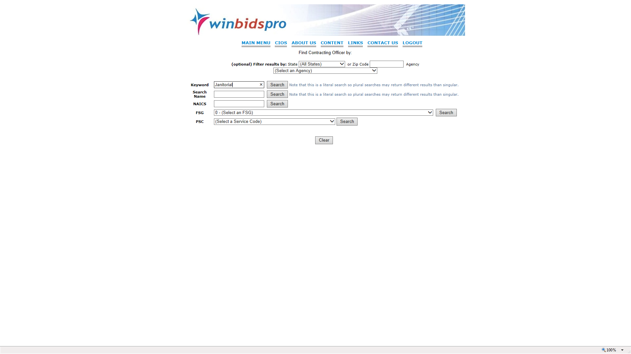
Home | Why NVSBC | Content | Training | Contact Us | Logout
This database allows you to determine a contracting officers name by what they intended to acquire via open solicitation- There are 55,000 contracting officers listed in the system and the database is updated each day- great way to understand where the money is being spent- next obstacle is to determine the end user– This database is unique to National Veteran Small Business Coalition

Slide 16
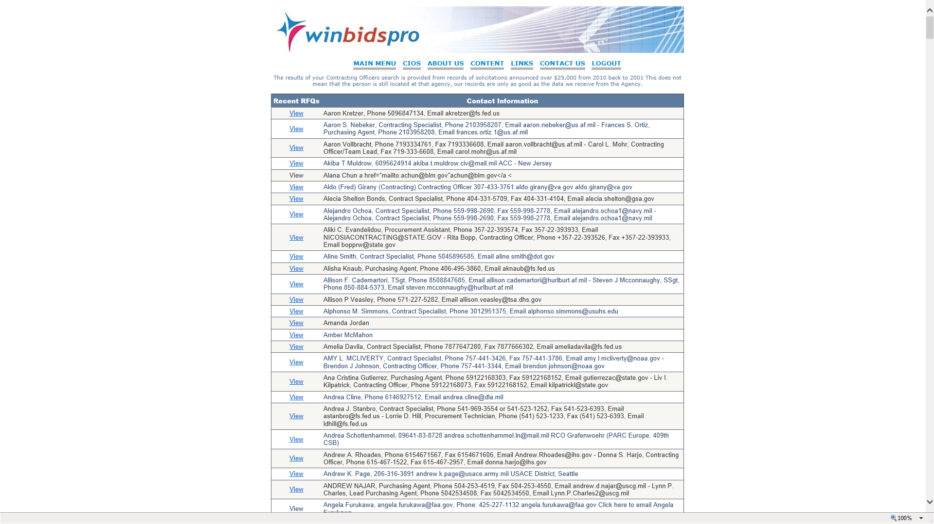
Home | Why NVSBC | Content | Training | Contact Us | Logout
ALL CONTRACTING OFFICERS may be found by Key word- NAICS- FSC-PSC and sub divided by State- Zip or agency- Multiples of the same manager may also be found as the data provided by the Government may be different in size

Slide 17
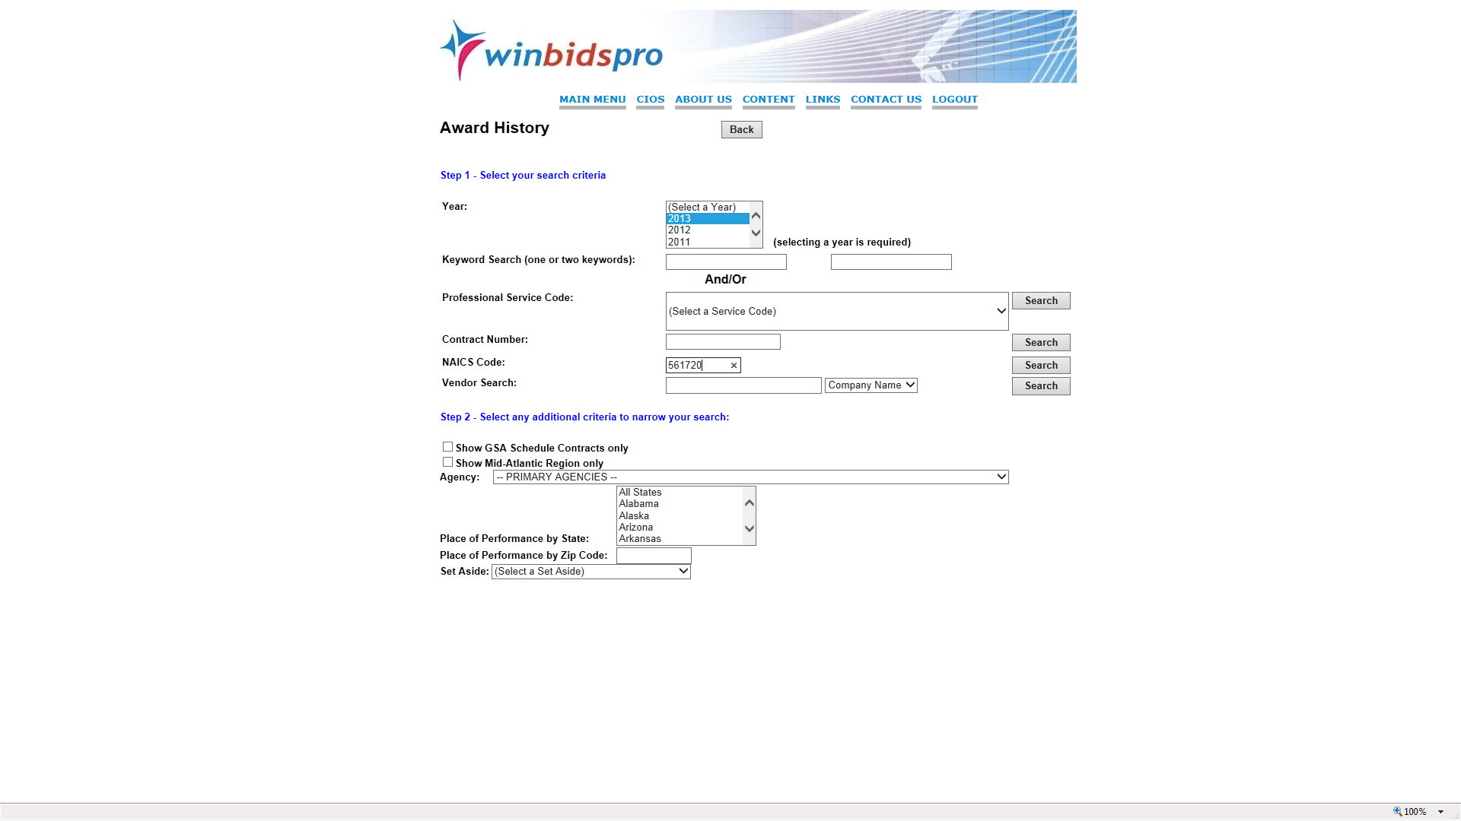
Home | Why NVSBC | Content | Training | Contact Us | Logout
National Veteran Small Business Coalition provides over 40 million award histories -
user must select year of results but has many other options and features

Slide 18
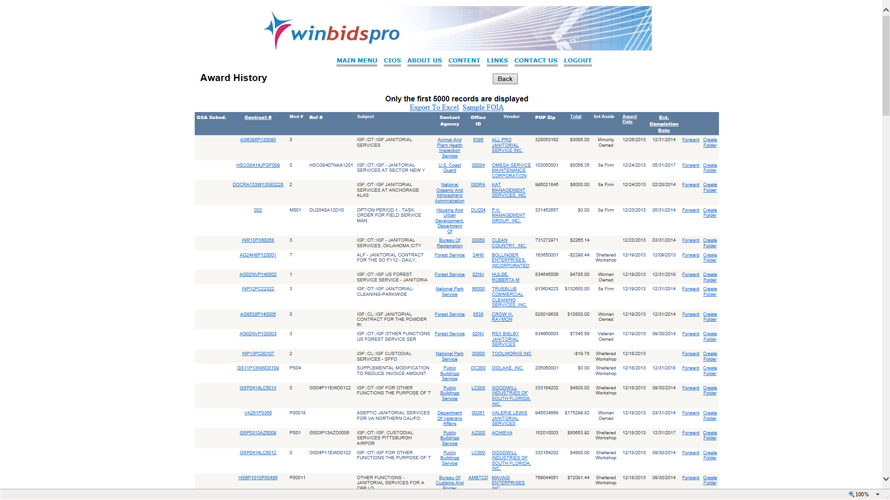
Award History goes back to 2004 and has several hyper-links

Slide 19
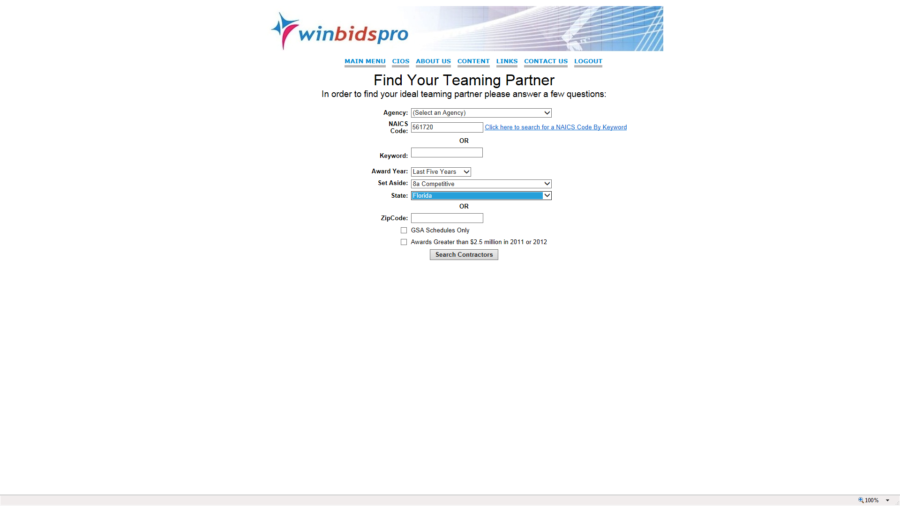
Home | Why NVSBC | Content | Training | Contact Us | Logout
Teaming Partner data searches require sufficient data as to provide appropriate results

Slide 20
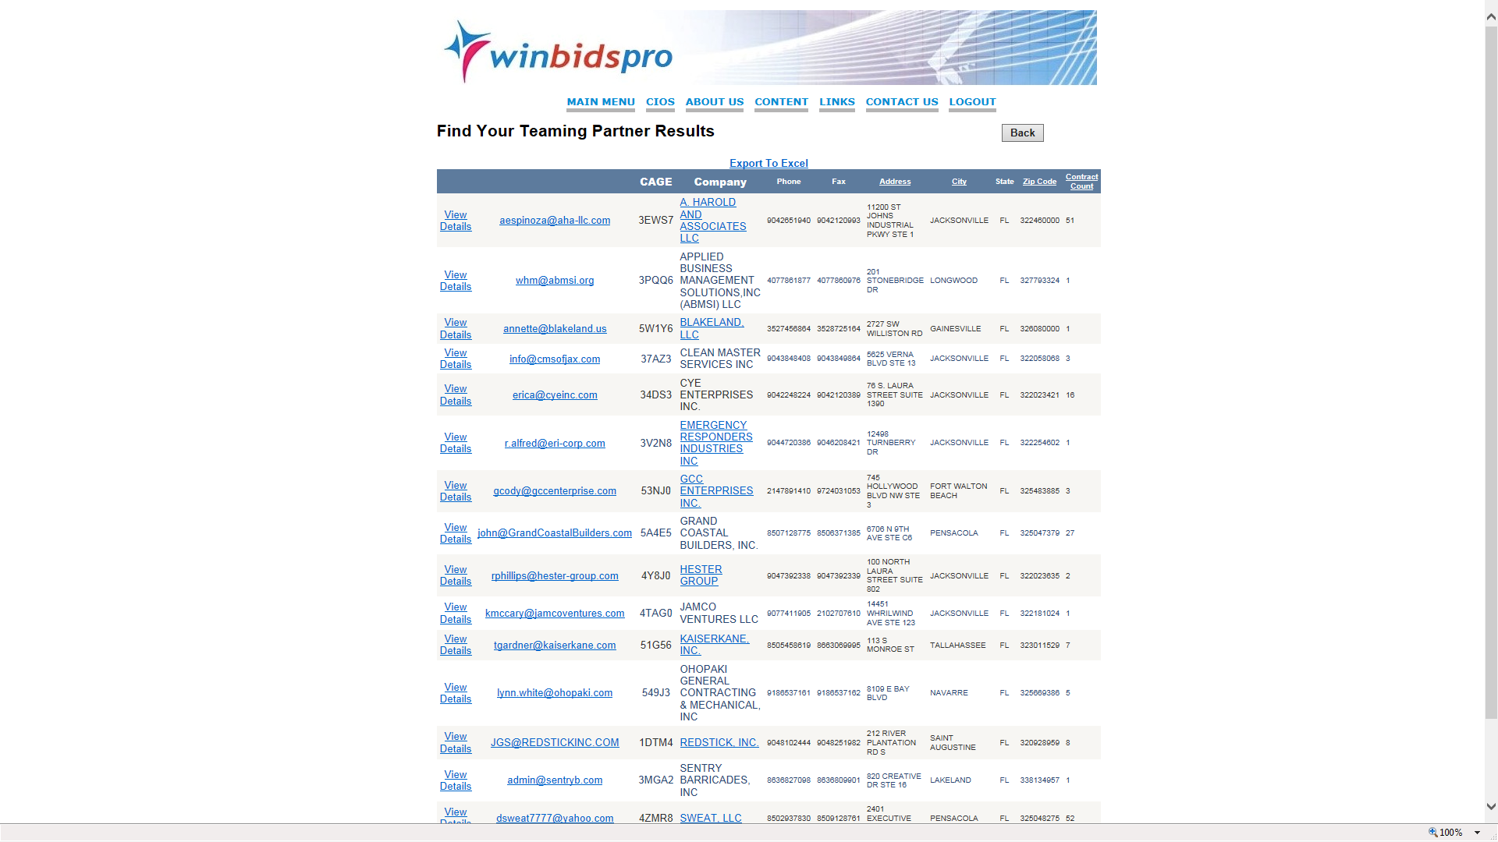
Home | Why NVSBC | Content | Training | Contact Us | Logout
The results of a sub contractor search will provide your choice of experienced or inexperienced partners - contact data and web sites are linked for user convenience

Slide 21
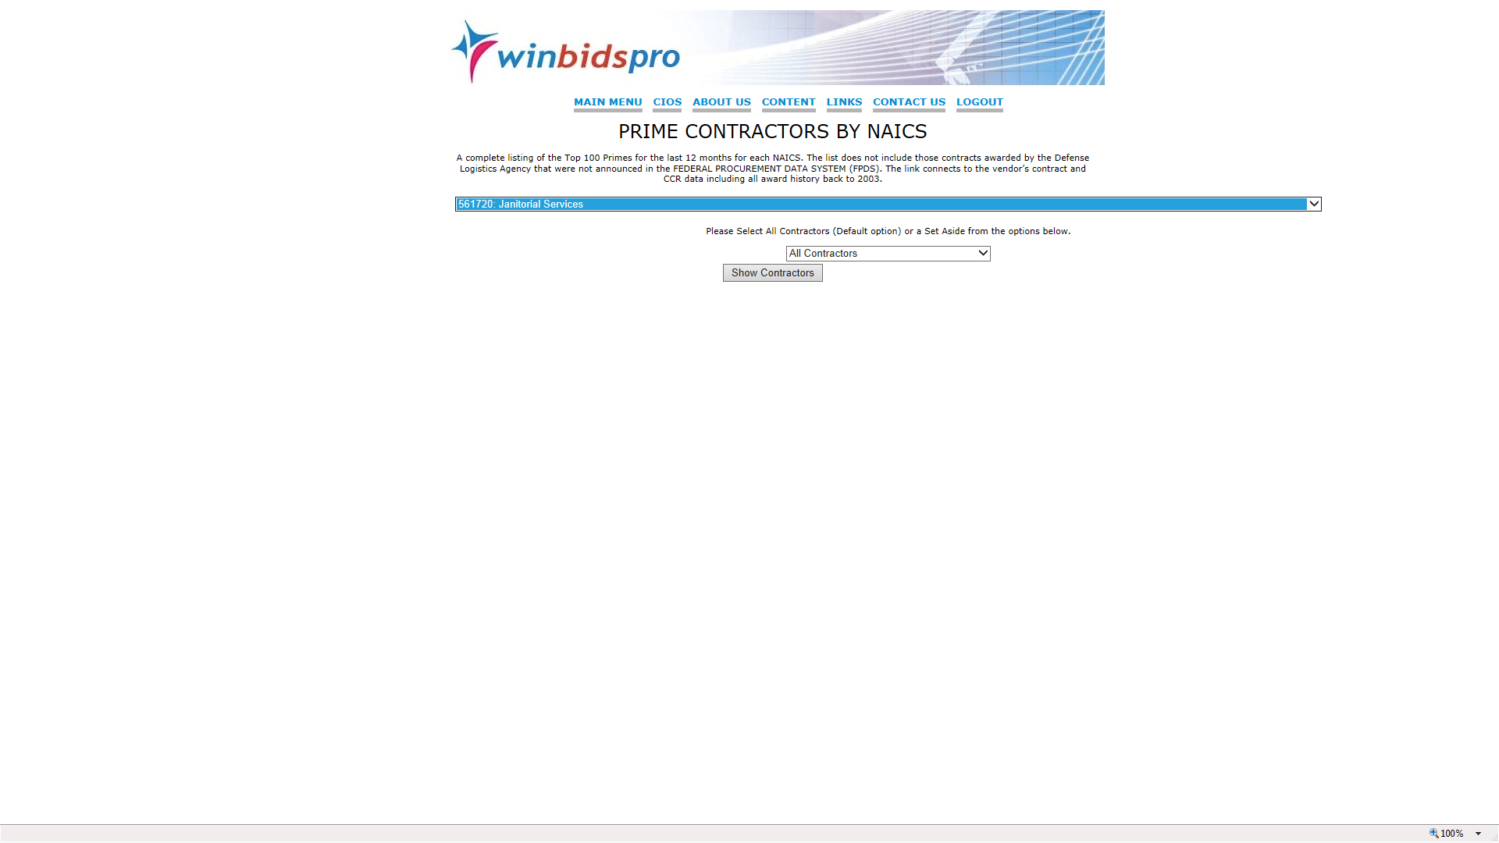
Home | Why NVSBC | Content | Training | Contact Us | Logout
Another unique feature of the database allows companies to identify contractors by NAICS- providing detailed contact for competitive reasons or teaming

Slide 22
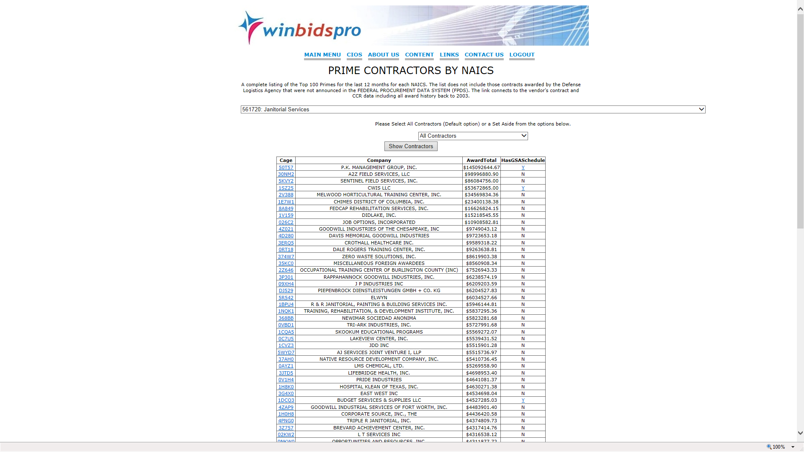
Home | Why NVSBC | Content | Training | Contact Us | Logout
A display of the Prime contractors by NAICS

Slide 23
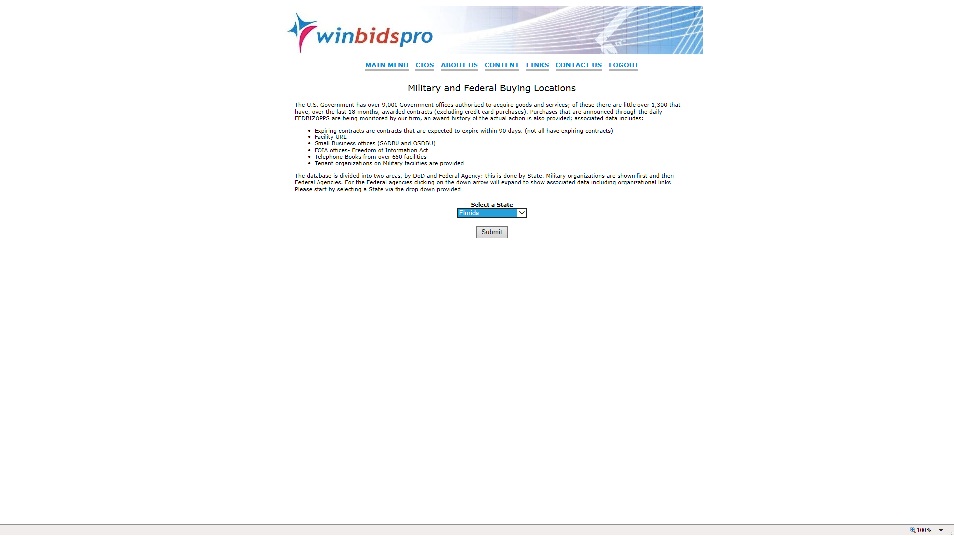
Home | Why NVSBC | Content | Training | Contact Us | Logout
Buying locations of Government locations details acquisitions by State- data shown breaks down what was acquired, when and contractors

Slide 24
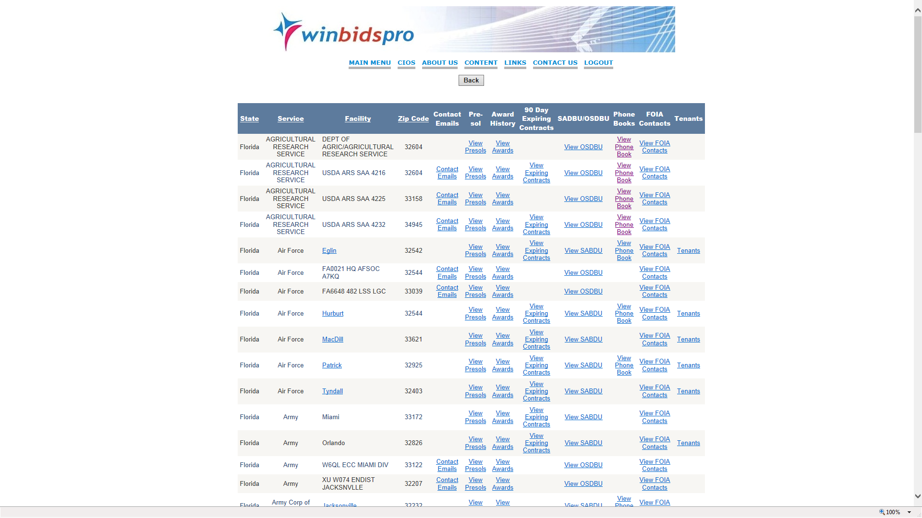
Home | Why NVSBC | Content | Training | Contact Us | Logout
The only complete database of all DoD acquisition sites - Pre-Sols are daily opportunities over $25,000 and updated each morning - View Awards are the awards given for that facility over the last four years

Slide 25
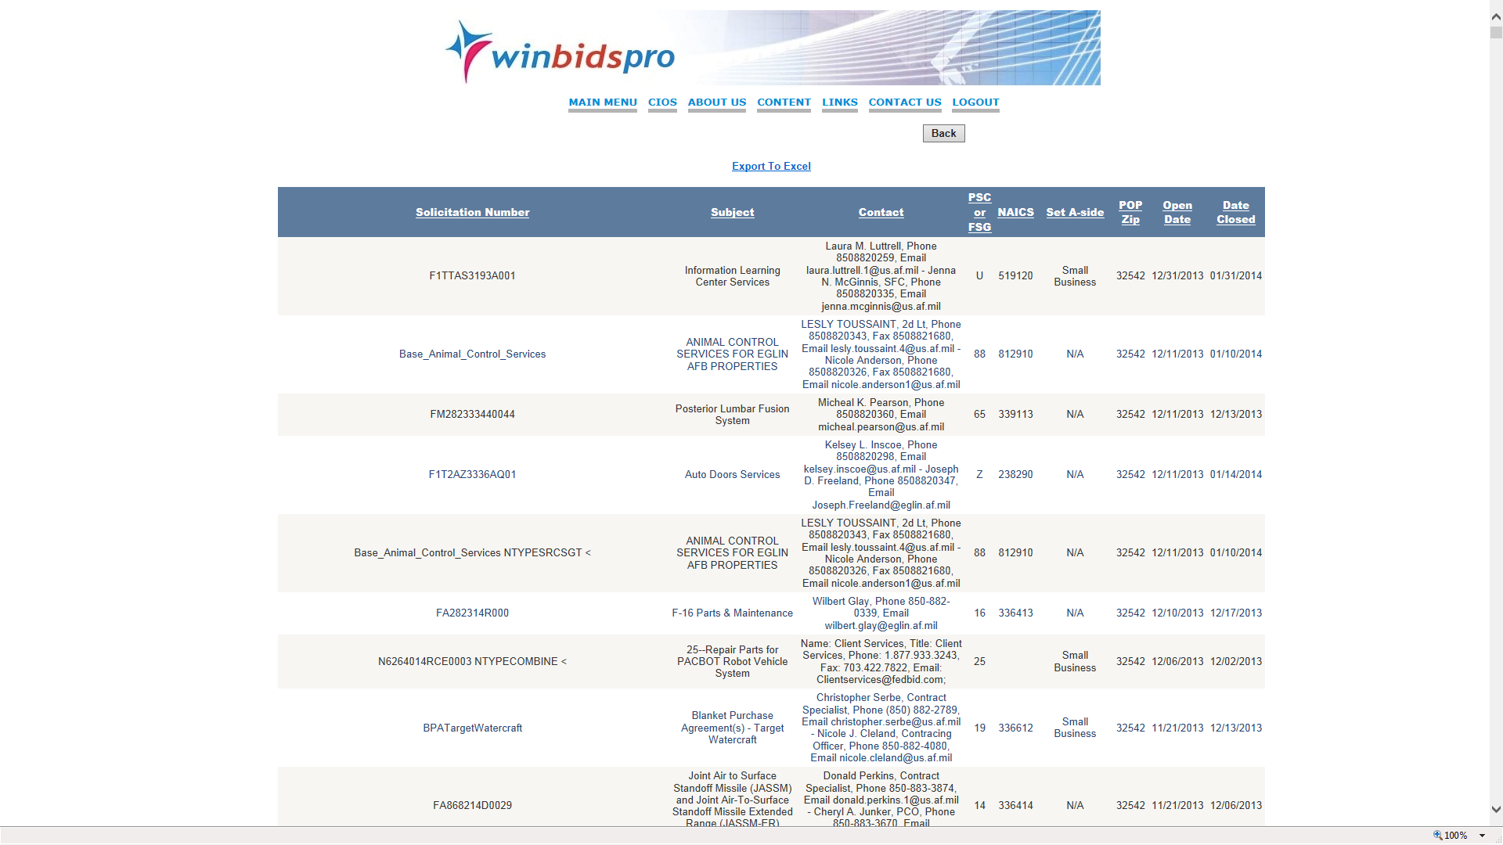
Home | Why NVSBC | Content | Training | Contact Us | Logout
The daily bids opportunities over $25,000 are provided by facility location- header choice may be changed and reorganized by POP ( Place of Performance) Federal Supply Group ( Parts) NAICS (Part category) PSC ( Services) as well as date issued or date closed- resultant data may be exported to Excel

Slide 26
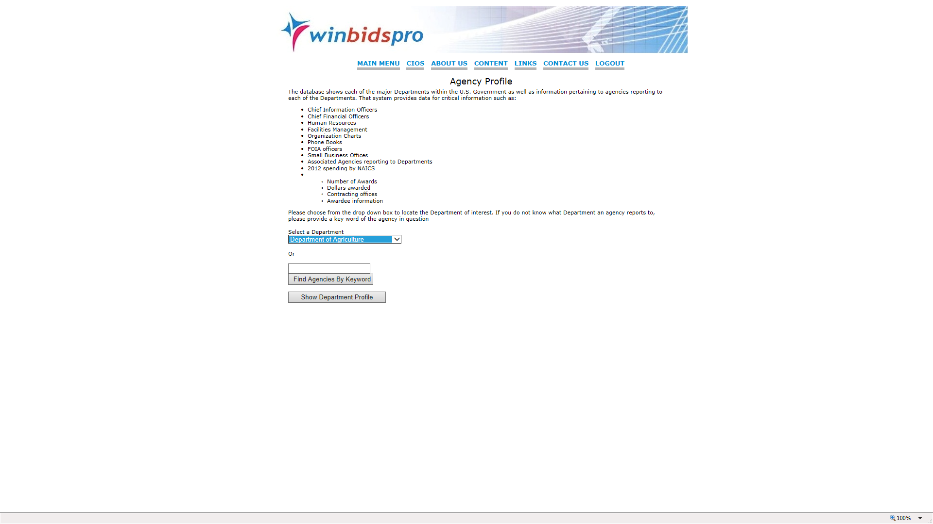
Home | Why NVSBC | Content | Training | Contact Us | Logout
Agency Profile, another unique feature of the system breaks down the 32 Departments and the buying agencies for each - dollars- contracting offices and vendors receiving contracts

Slide 27
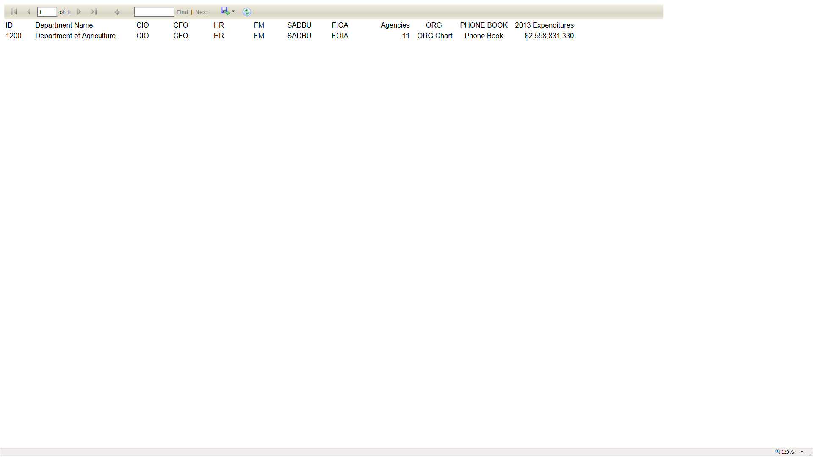
As part of the agency profile - Chief Information Officers - Chief Financial Officers - Human Resources and Facilities Managers contacts are prod along with phone books and organization charts

Slide 28
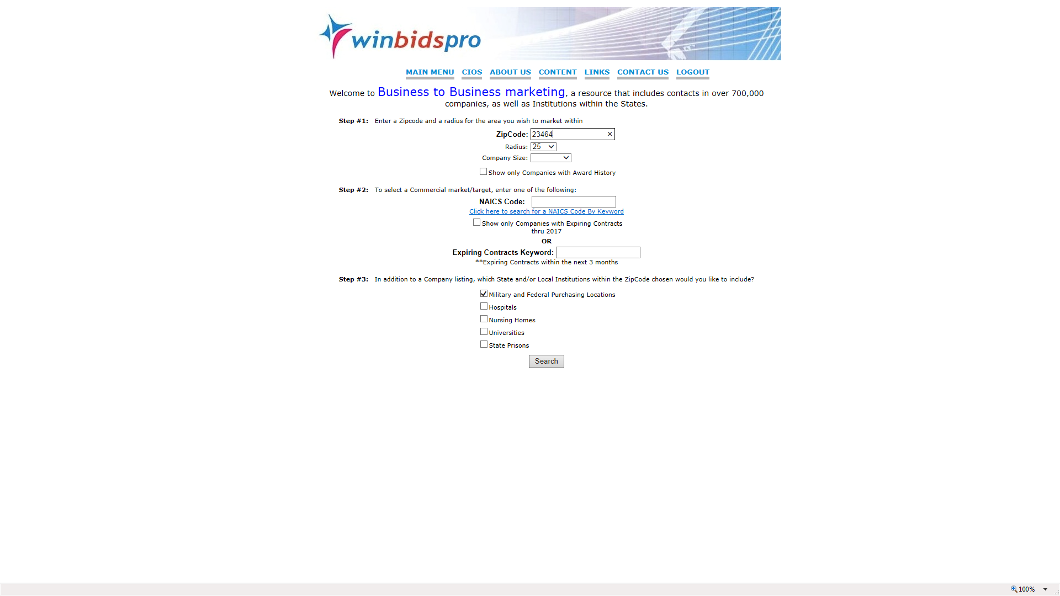
Home | Why NVSBC | Content | Training | Contact Us | Logout
Business to Business provides data by zip on over 700,000 companies registered with the Government - contact data and SAM material also provided

Slide 29
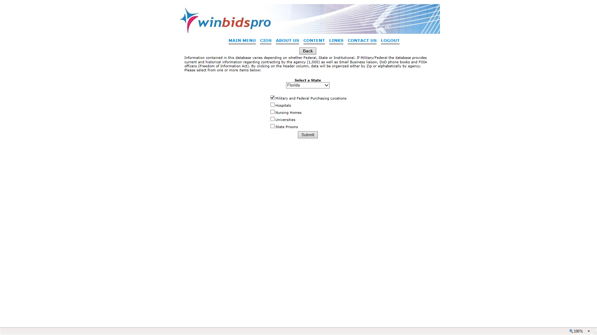
Home | Why NVSBC | Content | Training | Contact Us | Logout
A detail list by State of all pertinent buying activities is provided including Hospitals - Nursing Homes – Prisons - Universities as well as Military and Federal Agencies

Slide 30
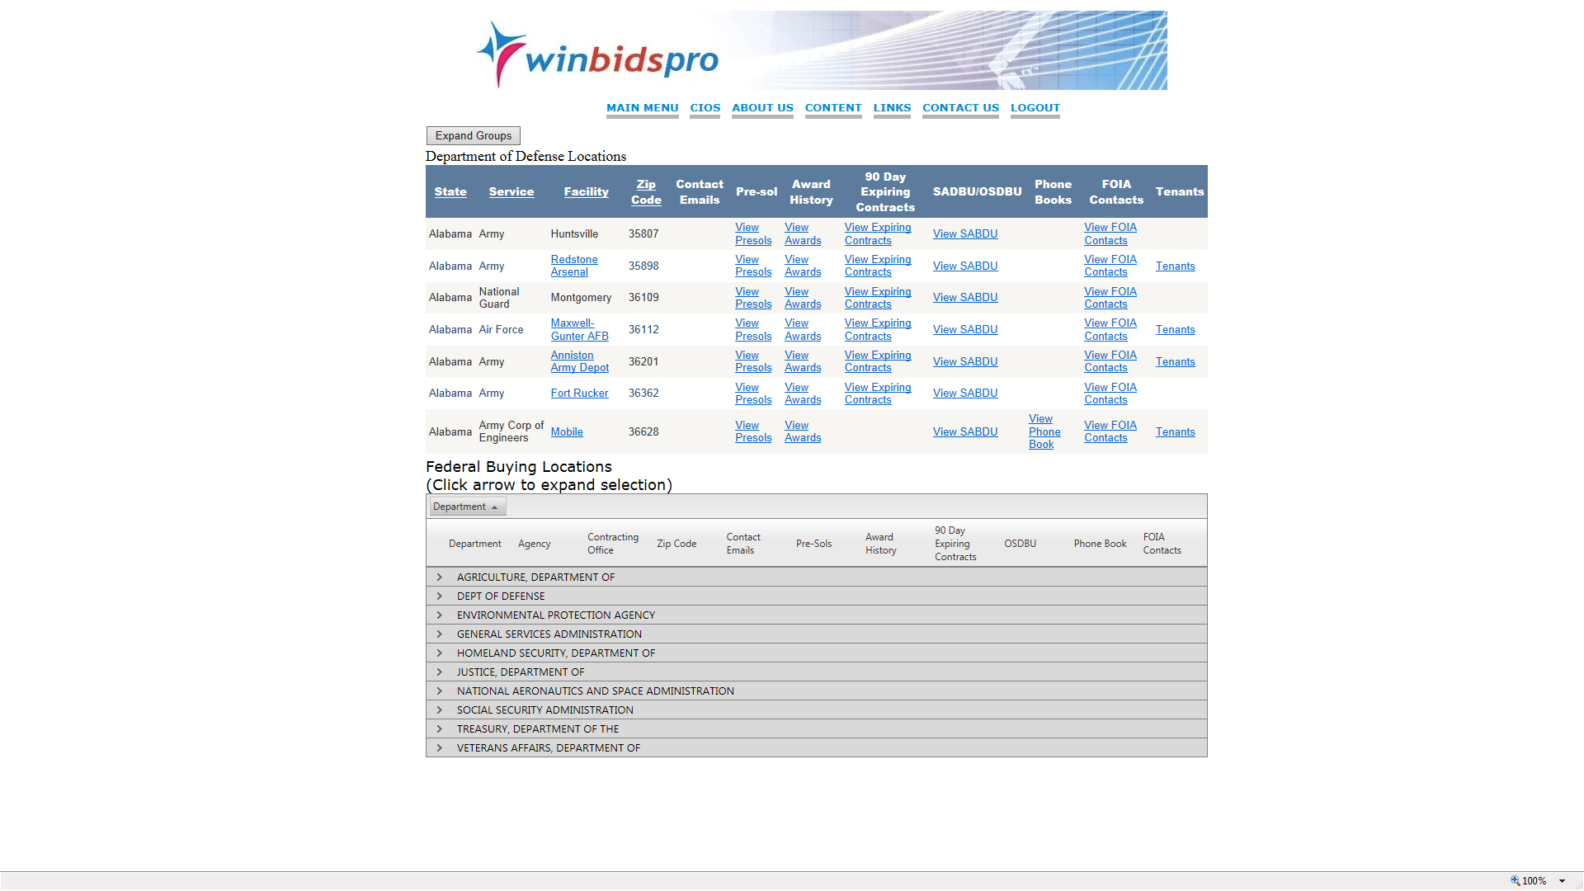
Home | Why NVSBC | Content | Training | Contact Us | Logout
When looking at Government organizations with Federal and State buying – Military shown first with Federal offering expansion by clicking on arrow

Slide 31
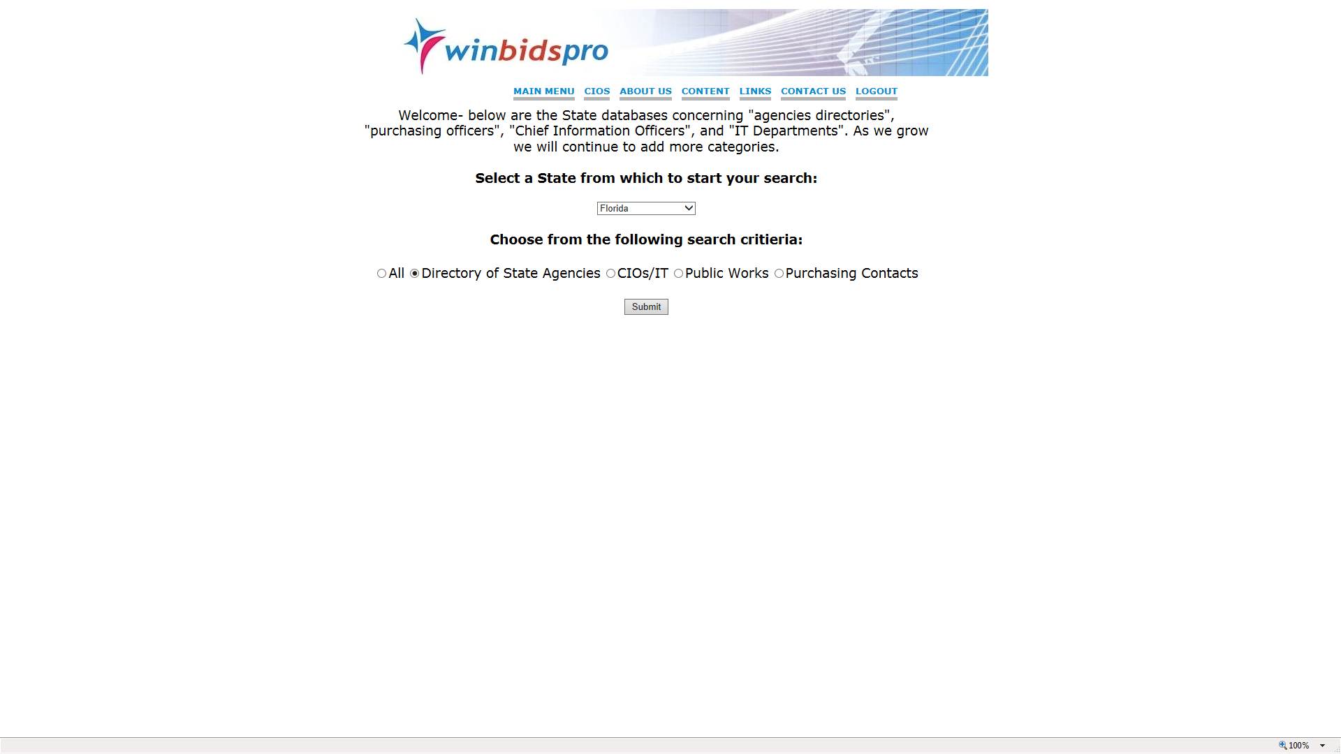
Home | Why NVSBC | Content | Training | Contact Us | Logout
The system offers over 1,500 State and local agency data – CIO – CFO - Public Works and buying offices - daily opportunities are provided in the system, collected from over 2,000 procurement sites

Slide 32
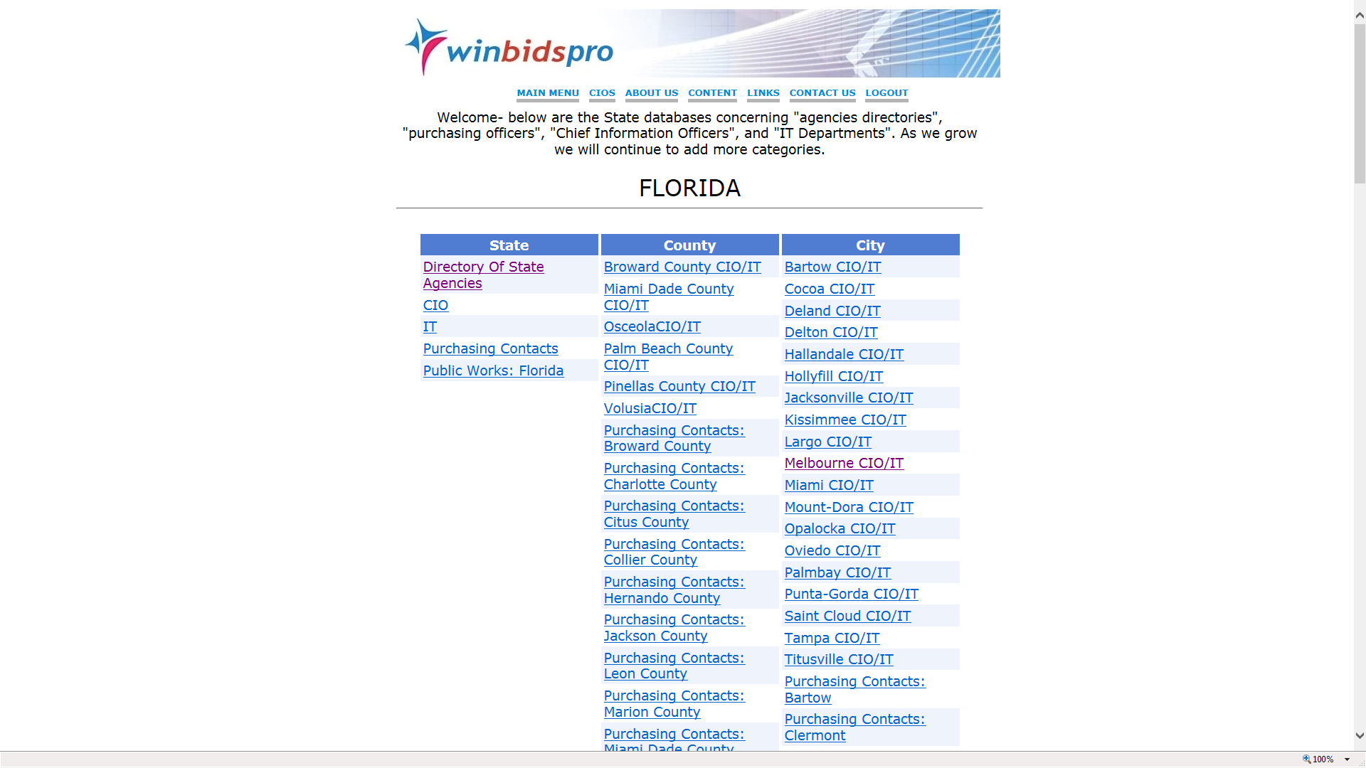
Home | Why NVSBC | Content | Training | Contact Us | Logout
Sample of expanded view by State- example is Florida

Slide 33
Daily Bids; 700,000 contractors; 55,000 contracting officers; DoD directory;
subcontracting partners; national stock number database and MORE!
SUMMARY- NO OTHER COMPANY OR GOVERNMENT ORGANIZATION HAS ALL THE DATA CONTAINED IN THE National Veteran Small Business Coalition DATABASE

